Slide 1
Elder Abuse Prevention and Response
Your Vital Role in Safeguarding Older and Vulnerable Adults
Presented by
The ElderSAFE Center
Notes:
Sydney

Slide 2
Presenters
Tovah Kasdin, ElderSAFE Center Director
Charles E. Smith Life Communities
KerryAnn Aleibar, ElderSAFE Center Program Manager
Charles E. Smith Life Communities
Sydney Palinkas, ElderSAFE Center Community Educator
Charles E. Smith Life Communities
Notes:
Team

Slide 3
Objectives
Lay the foundation with a discussion of trauma
Gain an understanding of elder abuse and its types
Discuss warning signs of abuse
Discuss reporting and Adult Protective Services
Learn about ElderSAFE and how it can be a resource
Notes:
Sydney

Slide 4
Trauma
Trauma is the unique individual experience of an event or enduring conditions, in which:
An individual’s ability to integrate his/her emotional experience is overwhelmed;
An individual experiences a threat to their life or a loved one’s;
There are long-lasting adverse effects to the individual’s functioning and their well-being
(SAMHSA, 2014)
Notes:
Sydney

Slide 5

Trauma Experiences
War / combat
Death of a loved one
Natural disaster
Divorce
Bullying
Sexual or physical assault
Miscarriages
Domestic violence

Slide 6

Understanding Trauma
Notes:
Sydney
How the brain reacts to trauma

Slide 7
Re-emergence of Trauma Responses Later in Life
Loss of loved ones
Retirement
Loss of control
A time of reflection
Illness symptoms may mirror trauma
(Cook, 2017)
Notes:
Sydney

Slide 8
Signs of Emotional Distress Due to Trauma
Intense emotional reactions that seem disproportionate to the situation
Hypervigilance
Dissociation
Panic attacks
Hypersensitivity to physical sensors
Somatic complaints
Triggers
Notes:
Sydney

Slide 9
Things to Remember
There are no “normal” reactions to trauma
Traumatic memories often resurface later in life / at the end of life
You do not need to know the whole story
Try to give back a sense of control and self-determination
Notes:
Sydney

Slide 10
Understanding Elder Abuse
Notes:
Tovah

Slide 11
The Definition of Elder Abuse
Elder abuse “includes physical, sexual or psychological abuse, as well as neglect, abandonment, and financial exploitation of an older person by another person or entity that occurs in any setting (e.g., home, community, or facility) either in a relationship where there is an expectation of trust and/or when an older person is targeted based on age or disability.”
(Elder Justice Roadmap report, 2014)
Notes:
Tovah

Slide 12

Elder Abuse Facts
The Scope of the Issue
Affects nearly 5 million individuals every year in the U.S.
1 in 10 older adults will experience abuse
For every case reported, 23 cases go unreported
(National Center on Elder Abuse, 2014; Acierno et al., 2010; Lifespan of Greater Rochester et al., 2011)
Notes:
Tovah

Slide 13
Who Commits Elder Abuse?
A Spouse or dating partner
Family Member (adult child, grandchild, niece, nephew, sibling, in-laws, etc.)
Caregiver
Professionals
Neighbor or friend
Stranger
Notes:
Tovah

Slide 14
Myths and Misconceptions
What are your thoughts?
Elder mistreatment should be confirmed before its reported.
If an older adult is cognitively impaired, they can’t accurately report abuse.
If an older person denies abuse, that means it did not happen.
If an older adult asks you not to report abuse, you need to honor their wishes.
Older adults should be able to make their own decisions even if they are bad decisions.
Elder abuse mostly takes place in nursing homes.
Notes:
KerryAnn
APS will do the investigation. You can make a report based on suspected abuse. And you must do that if you are a mandated reporter.
Too often the disclosures of adults with cognitive impairments are ignored. Abusers will even use that saying things like “Oh don’t listen to her, she’s senile”. Able to identify emotions.
Denying abuse is common. Many many reasons by victims deny abuse.
Especially since it is against best practice in the DV field, it can be hard to report abuse when the older adult asks you not to. But if you are working with an older adult that is vulnerable and you are a mandated reporter you must make that report.
Even if someone has a Power of Attorney or a Guardian there are can still be decisions they are able to make. As much as possible, its important to respect the decisions and self determination of elder adults.
Most elder abuse actually happens in the community,

Slide 15

Does caregiver stress / burnout cause elder abuse?
Notes:
KerryAnn
Caregiver Stress: Historically seen as the cause of abuse.
A factor, just like alcohol is a factor in DV or SA. Not the cause
Based on studies, that asked the abusers
In fact, in many cases the perpetrator of elder abuse is dependent on the victim, not the other way around
Evidence that they are rarely actually “out of control”

Slide 16
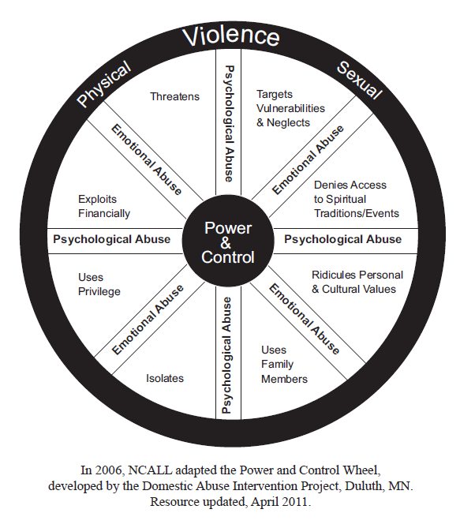
The Types of Abuse
Notes:
Sydney

Slide 17



Physical Abuse
Use of force causing pain, harm or physical injury.
Examples:
Kicking, hitting, pushing, slapping, pinching
Inappropriate use of medications
Unneeded physical restraints
Controlling access to / breaking assistive aides
Moving / handling roughly
Not respecting social distancing
Notes:
Sydney
Taking away assistive devices, pinching between the fingers, hitting under the clothes

Slide 18
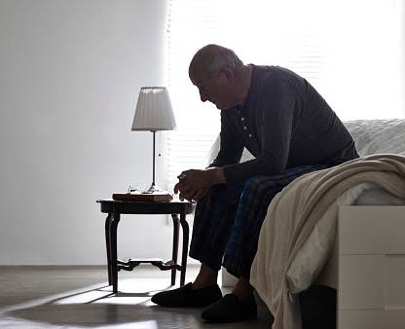
Psychological or Emotional Abuse
Mistreatment that affects someone’s emotional or mental health.
Examples:
Ignoring
Threats
Humiliation, mocking
Treating them like a child
Not allowing communication or visits with friends or family
Notes:
Sydney
Focus on person’s age, disability
Isolating from family or friends
Example: daughter not allowing mother to leave her bedroom
Gaslighting example

Slide 19
Financial Exploitation
The misuse of another’s person’s money, property or resources for self-gain.
Examples:
Taking benefits
Controlling bank accounts or credit cards
Forcing the older adult to change wills or property deeds
Taking possessions or money
Notes:
Sydney
Older adult might be giving the person their check book or credit card, but they were told “I will send you to a nursing home/ sell your house / hurt you if you don’t”

Slide 20
Sexual Abuse
Any type of non-consensual sexual act.
Examples:
Sexual assault
Inappropriate touching
Forced viewing of pornography
Taking photos without permission
Unwanted suggestive / sexual comments
Notes:
Sydney
“Violated” “Made me feel really uncomfortable”

Slide 21
Neglect
Willful deprivation of one’s basic needs (food, clothing, shelter, medicine, or personal hygiene).
Examples:
Not addressing pain
Not changing clothing / bathing
Not renewing / administering prescriptions
Not addressing toileting needs
Locking older adult in their apartment / bedroom
Leaving older adult in same position for long periods of time
Notes:
Sydney
Case example: compression stockings needing to be cut off

Slide 22
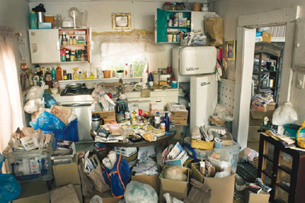
Self-Neglect
The inability / unwillingness to provide for one’s own physical or psychological needs which causes risk to that person’s health or safety.
Example:
Missing doctor appointments
Not maintaining hygiene
Not maintaining a hygienic, safe home
Not managing finances
Notes:
Sydney

Slide 23
Physical Warning Signs
Unexplained bruising, cuts, welts, linear marks
Untreated injuries / bedsores
Bloody, torn clothing
Consistently broken assistive devices or medical equipment
Poor hygiene (dental, nails)
Consistently in pain – pain not being addressed
Notes:
Sydney

Slide 24

Emotional / Behavioral Warning Signs
Fear
Changes in affect or personality
Depression, anxiety
Trouble sleeping / changes in appetite (not related to illness)
Low self-esteem
Concerned about finances
Secretiveness about finances
Notes:
Sydney

Slide 25
Warning Signs from the Family / Caregiver
Ignoring older adult
Overly defensive
Using language like:
  “Demented”, “Senile”, “Crazy”
  “She forces me to be rough”
  “Sometimes I get so stressed out….I regret things I’ve done.”
Notes:
Sydney

Slide 26
Warning Signs in the Home / Older Adult’s Room
Locks on outside of older adult’s bedroom door
Piles of unpaid bills
Lack of basic necessities
Hoarding
The home / bedroom is unsafe, unhygienic
  Can you safely walk through the home?
  Strong odor?
  Can you easily wash your hands / use the bathroom?
  Bugs? Rodents? Too many pets?

Slide 27
The Impact of Elder Abuse
300% higher risk of death
Depression, anxiety, increased mental impairment
3X more likely to be admitted to the hospital
4X more likely to be admitted to a nursing home
Greater reliance on social programs
(Dong et al. 2009; Fulmer, Rodgers & Pelger, 2013; Mouton et al, 2010; Dong & Simon, 2013; National Center on Elder Abuse, 2014)
Notes:
Sydney

Slide 28
Case Scenario #1 – Burt and his Grandson
You are the Care Manager for Burt, a 70 year old recently widowed male who lives alone. Since his wife’s passing, he has experienced a significant decline in his health. During your first intake assessment, you observed that Burt was unkempt, had difficulty walking and suffers from short term memory problems.
Your role as the Care Manager is to help Burt manage his medical appointments, coordinating home delivered meals, and home care services.
In one of your meetings, Burt mentions that his grandson has moved in with him. Burt is very happy to have his grandson’s company and support. He has been very lonely.
Notes:
Sydney

Slide 29
Case Scenario #1 (Cont.)
A few week after his grandson moved in, Burt begins missing his medical appointments and his appointments with you. He says that his grandson had planned to take him but then got too busy. Burt says it’s okay, he appreciates the help that he does get.
Burt mentions that his grandson’s girlfriend has also moved in to the house. He says he doesn’t mind. “Sometimes things can be difficult. They do some things I don’t like,” says Burt.
You find out that Burt’s grandson has fired the home health aide. When you call several times to check in, Burt is always unavailable. His grandson assures you that he and his girlfriend can handle Burt’s care. They don’t need any extra help.

Slide 30
Case Scenario #1: Discussion Questions
What factors make Burt vulnerable to elder abuse?
What would you do in this scenario?
Are there points you would / could have intervened earlier in this case?

Slide 31
Why Would An Older Adult Not Disclose Abuse?
Older adult may not know this treatment is abusive
Fear
Shame
They depend on the person hurting them
Abuser dependent on older adult
Cognitively impaired
Does not want abuser to be punished or taken away
Lack of culturally / linguistically relevant programs
Distrust of authorities
Notes:
KerryAnn

Slide 32
Reduce Barriers to Disclosure
Believe them
Take the time to listen
Be non-judgmental
Don’t give your opinion or feelings
Validate how brave they are to come forward
Talk in a safe place
Let them know about resources
Notes:
KerryAnn

Slide 33
Starting the Conversation
Is someone making you feel bad? Sad? Upset?
I noticed your friends aren’t calling as often. Is anyone stopping them from visiting?
Does anyone ever make you do things that make you feel uncomfortable?
Tell me more about what happens when your son gets upset with you.
Notes:
KerryAnn

Slide 34
Reporting Suspected Abuse
Notes:
Tovah

Slide 35
Mandated Reporters in Maryland
(Code of Maryland Statues, §14–302. )
Health Practitioner: any person who is authorized to practice healing under the Health Occupations Article.
Police Officer
Human Service Worker: any professional employee of any public or private health or social services agency or provider.
Financial Institutions
Notes:
Tovah

Slide 36
Who does this apply to?
(Maryland Code of Statutes, §14–101. )
Vulnerable Adults
“an adult who lacks the physical or mental capacity to provide for the adult’s daily needs.”
Notes:
Tovah

Slide 37
Adult Protective Services
Montgomery County 240-777-3000
Maryland State Hotline: 1-800-332-6347
Washington, DC: 202-541-3950
Northern Virginia: 1-888-832-3858
Notes:
Tovah

Slide 38
Case Scenario #2 – The Background
Mary Smith/Victim: 80 year old female capable of making her own decisions is bedbound and has a disability as a result of multiple strokes, reluctantly seeks to escape physical, emotional, financial abuse and neglect.
Jim Smith/Perpetrator: 60 year old unemployed husband who has been diagnosed with bipolar disorder and also struggling with alcohol issues. He does not seek consistent services or stay on his prescribed medications.
Living Arrangement: Mary is totally dependent on Jim for her daily care. She gets a monthly pension of $3,000, which she does not have access to as Jim handles all of the finances. Jim refuses to use any of the money to pay for help in the home. He often leaves Mary home alone for long periods of time unattended while he goes out drinking with his friends.
Notes:
KerryAnn

Slide 39
Case Scenario #2: The Incident
Situation: Recently, a neighbor rang the doorbell to deliver mail that came to the wrong address, and when Jim opened up the door, the neighbor saw Mary lying on the floor with clothes and trash around her. Jim quickly took the mail and closed the door. The neighbor then heard yelling followed by a slapping sound and then screams from Mary. The neighbor grew concerned and called the police.
Police involvement: Police came out and spoke to the neighbor. Police then spoke to Mary and Jim together and both denied abuse. Police did not notice any injuries on Mary. Police declined to write an incident report because they did not have probable cause and neighbor did not see the alleged slap. Police called Adult Protective Services per protocol to follow up.
Notes:
KerryAnn

Slide 40
Case Scenario #2: The Incident (Cont.)
Adult Protective Services (APS) involvement: Adult Protective Services called the following day and Jim held the phone for Mary to talk and she denied abuse. Adult Protective Service asked Jim if he needed additional help to care for Mary and he said no. Investigation was not initiated.
Mary’s Hospitalization: Two days later Mary was admitted to hospital after a fall. She had bruises on her face and upper torso. Additionally, she was underweight, dehydrated, and had a large bedsore on her buttocks. Hospital social worker interviewed Mary separately from Jim. Mary begged social worker not to send her home and revealed she was afraid of Jim and later admitted he slapped her and pushed her out of her bed. Social Worker called Adult Protective Services to file a mandatory report of abuse. Adult Protective Services investigated and found abuse and in turn called the local shelter for older adults to shelter Mary temporarily until safe permanent housing could be secured.
Notes:
KerryAnn

Slide 41
Case Scenario #2: Discussion Questions
Did each of the following individual agencies adequately do their jobs: Adult Protective Services, Police, and Hospital?
Did each of the following agencies and individuals: Adult Protective Services, Police, Hospital, neighbor coordinate adequately to protect Mary? What are some evident gaps in how the case was handled and what are your key concerns? How could coordination be improved?
How does this case reflect societal attitudes towards abuse in the older adult population?
There are some common risks factors for a caretaker to become a perpetrator of elder abuse. Were there any risk factors evident in this example?
What are best practices that are recommended in working with individuals affected by domestic violence that were not used in this case?
Notes:
KerryAnn

Slide 42

Notes:
KerryAnn

Slide 43
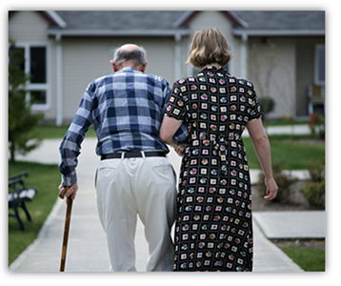
Client Services
Language-accessible helpline
  Monday – Friday: 9am – 5pm
  301-816-5099
Temporary, safe shelter
Notes:
KerryAnn

Slide 44
Client Eligibility
60 years of age or older
A victim of one or more of the following types of abuse (physical, sexual, psychological, financial, neglect) or is at risk for experiencing abuse
Referred by an agency or program
Willing to be placed in temporary shelter
Agree to not contact abuser during shelter stay
Referrals accepted from Maryland, Washington DC and Northern Virginia
Please note:
**ElderSAFE will accept clients without insurance
**Self neglect and homeless cases are not accepted
Notes:
KerryAnn

Slide 45
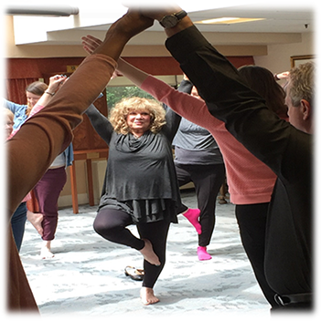
Services in Shelter
Medical
Psychological
Physical, occupational and/or speech therapy
Spiritual support
Social Services (safe discharge)
Legal referrals
Specialized trauma therapy
Holistic therapy program
Notes:
KerryAnn

Slide 46
The ElderSAFE Center’s Community Resource Guide
Created to connect older adults—and the professionals, volunteers and caregivers who assist them—to community resources to promote safe and healthy living.
Available in English, Spanish, Russian, and Mandarin.
Available to download from our website or in hard copy.
Notes:
KerrryAnn

Slide 47

Questions??

Slide 48
ElderSAFE Contacts
Tovah Kasdin, J.D.
Director
301-770-8494
kasdin@ceslc.org
KerryAnn Aleibar, LCSW-C
Program Manager
301-816-5045
aleibar@ceslc.org
Sydney Palinkas, LGSW
Community Educator
301-770-8365
palinkas@ceslc.org
Language Accessible Helpline:
301-816-5099 (Mon-Fri 9am-5pm)
Website: www.smithlifecommunities.org

Slide 49
References
Acierno, R. et al., (2009). National Elder Mistreatment Study. (U.S. Department of Justice grant report, NCJ 226456, March 2009), https://www.ncjrs.gov/pdffiles1/nij/grants/226456.pdf
Cook, J. (2017). Trauma and PTSD in Older Adults. Yale School of Medicine. National Center for PTSD. https://www.ptsd.va.gov/professional/consult/2017lecture_archive/02152017_lecture_slides.pdf
Dong, X, Simon, M., Mendes de Leon, C., Fulmer, T., Beck, T., Hebert, L. (2009). Elder self-neglect and abuse and mortality risk in a community-dwelling population. Journal of the American Medical Association, 302(5), 517–526. doi: 10.1001/jama.2009.1109
Dong, X. Q., & Simon, M. A. (2013). Elder abuse as a risk factor for hospitalization in older persons. JAMA Internal Medicine, 173 (10), 911–917. doi: 10.1001/jamainternmed.2013.238
Fulmer, T., Rodgers, R. F., & Pelger, A. (2013). Verbal mistreatment of the elderly. Journal of Elder Abuse & Neglect, 26(4), 351–364
Lifespan of Greater Rochester, Weill Cornell Medical Center of Cornell University, & New York City Department for the Aging. (2011). Under the radar: New York State elder abuse prevalence study. Self-reported prevalence and documented case surveys, Final report. New York, NY: William B. Hoyt Memorial New York State Children and Family Trust Fund, and the New York State Office of Children and Family Services
National Center on Elder Abuse. (2014). The Elder Justice Roadmap, (Washington, DC: Administration on Aging, U.S. Department of Health and Human Services), http://www.ncea.acl.gov/library/gov_report/docs/ejrp_roadmap.pdf

Slide 50
Thank You

